Slide 1
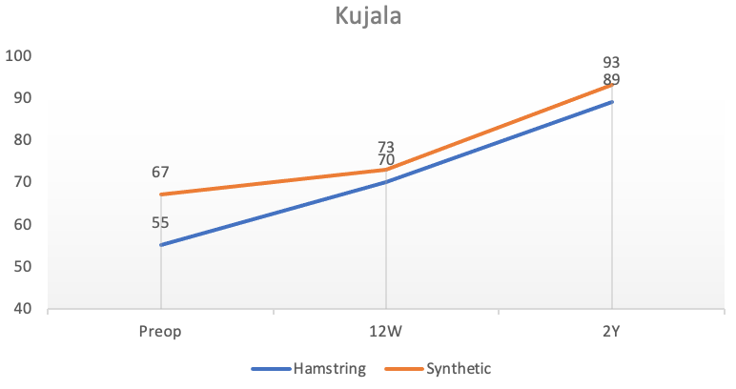
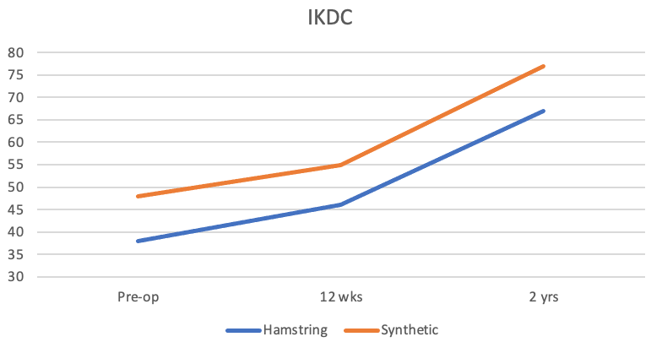
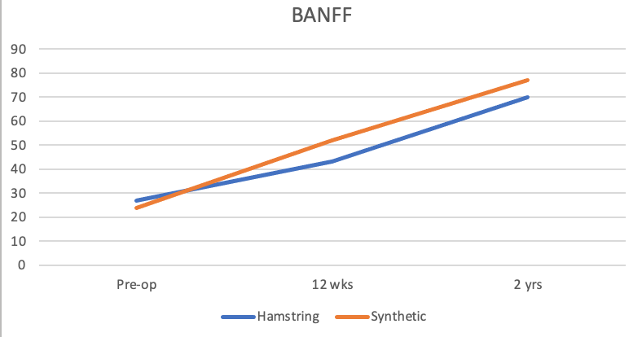
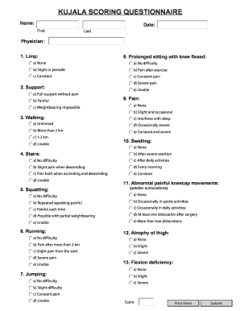
Synthetic versus Autologous reconstruction (Syn-VAR) Randomised Control Trial (RCT) of the Medial Patellofemoral Ligament (MPFL)
Mr S.Matthews, Mr A.Tucker, Mr J.Graham, Mr D.Acton
Introduction
Results
Patella instability can be a debilitating pathology for patients with limitations to activities of daily living and sporting activities. The medial patellofemoral ligament (MPFL) has been shown to be one of the most important factors contributing to patella stability. There have been numerous reported methods to treat patella instability. Reconstruction of the MPFL has come to the forefront as providing favourable outcome (1). This study Syn-VAR RCT is the first of its kind comparing hamstrings autograft v synthetic neoligament for MPFL reconstruction.
20 patients included in the trial, average age of the cohort was 19 including 9 females and 11 males underwent MPFL reconstruction. 10 had synthetic neoligament as the graft and 10 had autologous hamstring tendon graft. In the hamstring tendon cohort at 12 weeks and 2 years Kujala improvement was 18 and 32 (both p<0.05) compared to the synthetic group where the increase was 2 and 20 (p<0.05). All secondary score improvements at 2 years were significant (p<0.05) with no difference in any score at all time intervals when comparing both groups (p<0.05). Graph 1 below demonstrates the improvement in Kujala scores from Pre-op, 12 weeks & 2 years. Graphs 2 & 3 demonstrate the same trend in IKDC & BANFF scores
Study Aims
Our aim is to evaluate short and long term patient related outcomes measures (PROMs) following synthetic / autologous MPFL reconstruction in a heterogenous cohort of patients with recurrent patellar instability to establish if there is any statistically significant difference in patient outcomes between the grafts utilized. Primary outcome-Kujala score (2) (Figure 1) pre-operatively, 12 weeks & 2 years post-operatively. Secondary outcomes assessed other PROMs of widely utilized in patella instability such as IKDC & BANFF.
Graph 1
Methods
This was single blinded randomized control trial completed in a single orthopaedic unit at Altnagelvin Area Hospital, with a specialist surgeon in soft-tissue knee reconstruction over a 3 year period 2016-2019. Inclusion criteria included: aged over 14 years, closed proximal tibial physes, patella instability with confirmed MPFL rupture, failed conservative management. Exclusion criteria included: previous surgical intervention for instability, patients who require boney correction procedures, known hypersensitivity to graft material. Both groups underwent standardized rehabilitation with specialist physiotherapists. Documentation of the Kujala score for patella instability was completed by the operative surgeon at review. 20 Patients who met the inclusion criteria were recruited and randomized to either receive the synthetic neoligament or hamstrings tendon graft as their MPFL reconstruction.
Graph 2
Graph 3
Figure 1
Conclusion
Our RCT validates the non-inferiority of synthetic MPFL reconstruction as a treatment for restoring patellar stability in a small heterogenous group with positive long term data and minimal morbidity.
References
1. Mehta, V.M., Inoue, M., Nomura, E. and Fithian, D.C., 2007. An algorithm guiding the evaluation and treatment of acute primary patellar dislocations. Sports medicine and arthroscopy review, 15(2), pp.78-81
2. Kujala UM, Jaakkola LH, Koskinen SK, Taimela S, Hurme M, Nelimarkka O. Scoring of patellofemoral disorders. Arthroscopy. 1993;9(2):159–63.

